Slide 1
FRACTURES
GILBERT R.M
KMTC MACHAKOS

Slide 2
Introduction
Break in the structural continuity of a bone
If the overlying skin remains intact - closed (simple fracture)
If skin or one of the body cavities is breached- open (compound fracture)

Slide 3
Types of Fracture
Divided in to
Complete
Incomplete

Slide 4
Complete fracture
Bone is split into two or more fragments. The
fracture pattern on x-ray can help predict behaviour
after reduction
in a transverse fracture the fragments usually remain in place after reduction
if it is oblique or spiral, they tend to shorten and re-displace even if the bone is splinted.
In an impacted fracture the fragments are jammed tightly together and the fracture line is indistinct.
A comminuted fracture is one in which there are more than two fragments

Slide 5
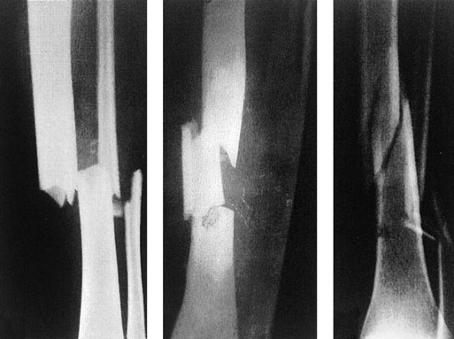
Complete fractures: (a) transverse; (b) segmental and (c) spiral

Slide 6
Incomplete fracture
The bone is incompletely divided and the periosteum remains in continuity
Greenstick fracture : bone is buckled or bent
Mainly seen in children, because of their springy bones
Plastically deformed bones
Compressed fracture: crumpled cancellous bone
Seen in adults, mainly in vertebral bodies, calcaneum and tibial plateu

Slide 7
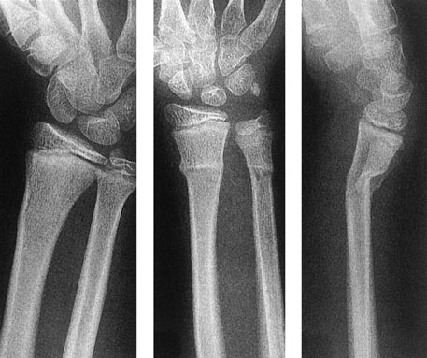
Incomplete fractures: (a) buckle or torus and (b,c)) greenstick.

Slide 8
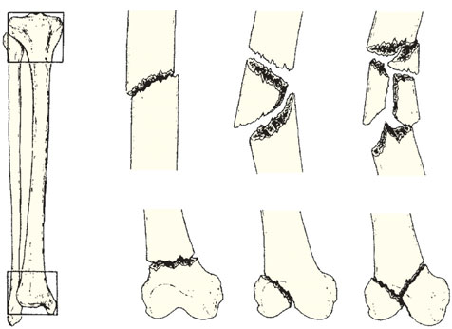
Muller’s Classification
(a) Each long bone has three
segments – proximal
Diaphyseal
Distal
the proximal and distal segments are each defined by a square based on
the widest part of the bone.
(b,c,d) Diaphyseal fractures
may be simple
wedge
complex.
(e,f,g) Proximal and distal fractures may be extra-articular,
partial articular
complete articular.

Slide 9
How fractures are displaced
Fractures can be displaced by:
Force of the injury
Effects of gravity
Pull of muscles attached to the site

Slide 10
Types of displacement
Translation (shift)- the fragments may shift sideways, backwards or forwards
Angulation (tilt)- mal alignment if unconnected will lead to limb deformity
Rotation (twist)- rotational deformity
Length- can cause shortening of the bone

Slide 11
Mechanism of injury
Injury
Repetitive stress
Pathological fractures

Slide 12
INJURY
Direct force- With a direct force, the bone breaks at the point of impact; the soft tissues also are damaged.
Indirect force-the bone breaks at a distance from where the force is applied.

Slide 13
Some fracture patterns reveals the dominant mechanism:
Spiral pattern- twisting
Oblique- compression
Triangular- bending
Transverse- tension

Slide 14
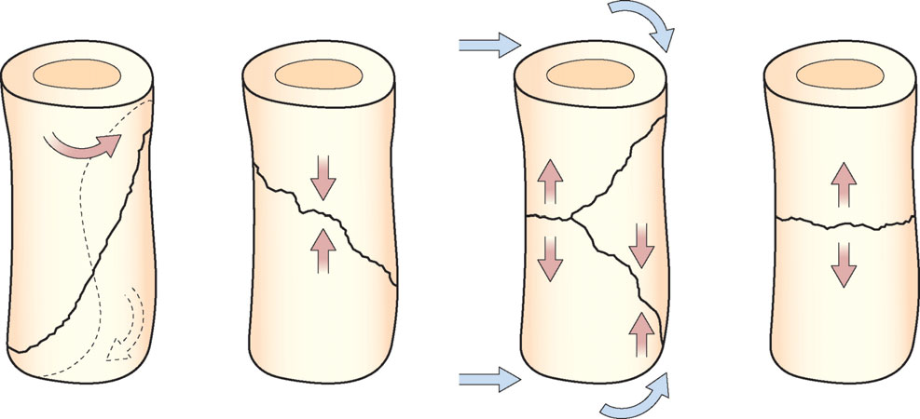
Some fracture patterns suggest the causal mechanism: (a) spiral pattern (twisting); (b) short oblique pattern (compression); (c) triangular ‘butterfly’ fragment (bending) and (d) transverse pattern (tension). Spiral and some (long) oblique patterns are usually due to low-energy indirect injuries; bending and transverse patterns are caused by high-energy direct trauma.

Slide 15
FATIGUE OR STRESS FRACTURES-
Occur in normal bone, subject to repeated heavy loading, typically in athletes, dancers or military personnel.
Drugs like steroids and methotrexate

Slide 16
PATHOLOGICAL FRACTURES- Occurs in a bone that is made weak by some disease.
Causes-
Inflammatory- Osteomyelitis
Neoplastic- giant cell tumour, Ewings sarcoma,
secondaries

Slide 17
Miscellaneous bone conditions- simple bone cyst, anuerysmal bone cyst
Heriditary- Osteogenesis imperfecta, Osteopetrosis
Other acquired generalised diseases- Osteoporosis, osteomalacia, rickets

Slide 18
BONE HEALING
PRIMARY FRACTURE HEALING
refers to fractures treated operatively without
callus formation
SECONDARY FRACTURE HEALING
refers to (a) fractures treated non-operatively,
with the formation of callus and no disturbance
of hematoma; (b) fractures operated without
disturbance of hematoma

Slide 19
FACTORS AFFECTING BONE HEALING
Age: Fractures unite faster in children
Type of bone: Faster union in flat and cancellous bone
Pattern of fracture: Spiral # > oblique # > transverse # > comminuted #
Disturbed pathoanatomy: soft tissue interposition and ischaemic # prevent faster healing

Slide 20
(E)Type of reduction: good apposition of
fracture results in faster healing
(F)Immobilisation: depends on the fracture site
eg. Fracture ribs and scapula do not require
immobilisation
(G)Open fractures: often go into delayed union
and non-union
(H)Compression of fracture site: enhances
union(cancellous bone) and primary bone
healing(cortical bone)

Slide 21
HEALING BY CALLUS
STAGE 1: TISSUE DESTRUCTION AND HEMATOMA FORMATION
- lasts for 7 days
- blood leaks out of torn vessels and forms a
hematoma between and around fracture
- periosteum and local soft tissues are stripped off
- ischaemic necrosis – death of some osteocytes with sensitization of the remaining precursor cells

Slide 22
STAGE 2: INFLAMMATION AND CELLULAR PROLIFERATION/GRANULATION TISSUE
- lasts for 2-3 weeks
- precursor cells form cells that differentiate and organize to provide q vessels, fibroblasts, osteoblasts etc
- soft granulation tissue formed between
fracture fragments, providing anchorage to fracture
- hematoma is slowly absorbed and fine new capillaries grow into the area

Slide 23
STAGE 3: CALLUS FORMATION
- lasts for 4-12 weeks
- granulation tissue differentiates and creates osteoblasts, laying down intercellular matrix impregnated with calcium salts
- formation of callus/woven bone
- provides good strength to the fracture,
decreasing the movements at the fracture
site and causes union in about 4 weeks

Slide 24
STAGE 4: REMODELLING
- takes 1-4 years for the bone to become
strong enough to carry weight
- with continuing osteoclastic and osteoblastic activities, the woven bone gets transformed into lamellar bone
- osteoblasts fill in the remaining gap between the new bone and the fragments to strengthen the bone

Slide 25
STAGE 5: MODELLING
- stage where the bone is gradually strengthened
- shapening of the cortices occurs at the
endosteal and periosteal surfaces
- all these occur when the person starts resuming his activities ie bearing weight and muscle forces
- thicker lamellae are laid down where high
stresses are present, unwanted buttresses are carved away and medullary cavity is reformed

Slide 28
HEALING BY DIRECT UNION
Formation of callus requires stimulus from movement
In cases of impacted fracture in cancellous bone or a fracture immobilised by the use of metal plate, callus will not be formed and hence the fracture will heal by direct union

Slide 29
Osteoblastic new bone formation occurs directly between the fracture fragments
New capillaries and osteoprogenitor cells grow in from the edges and lay down new bone on the exposed surface (gap healing)
Lamellar bone is produced in the narrow crevices (<200μm) while woven bone is produced in the wider gaps which is then remodelled into lamellar bone

Slide 30
Penetration and bridging of the fracture by
osteoclasts and osteoblasts in 3-4 weeks.
Intimacy of the contact surfaces lead to
internal bridging without intermediate stages
(contact healing)

Slide 31
CLINICAL PRESENTATION OF FRACTURES

Slide 32
In the Casualty..
Take a Brief History.
General Particulars:
AGE & SEX
Children and the elderly
Different mechanisms of injury : Traumatic , Pathological
Post menopausal women : Osteoporosis and pathological fractures.
HISTORY OF TRAUMA – Ascertaining the mechanism of injury is important, helps understand symptoms and aids examination.

Slide 33
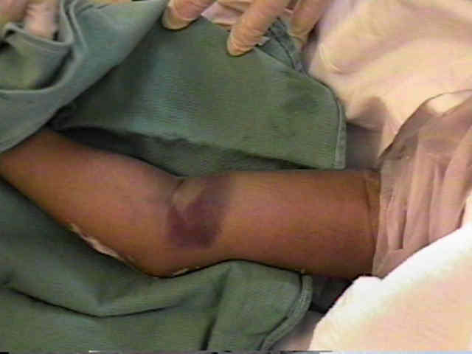
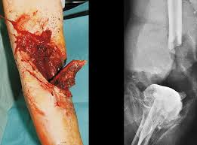
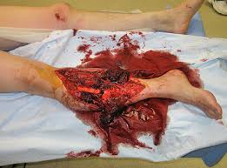

Slide 34
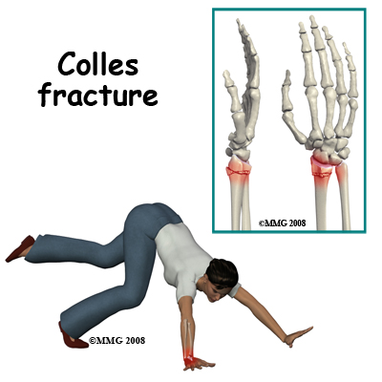
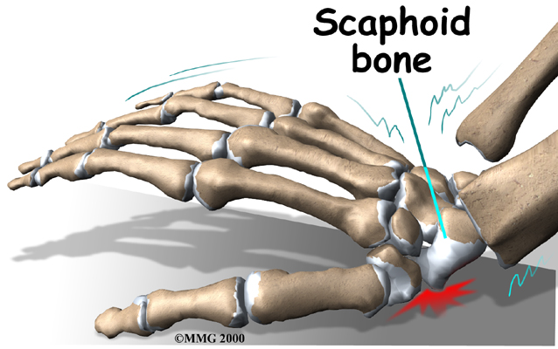
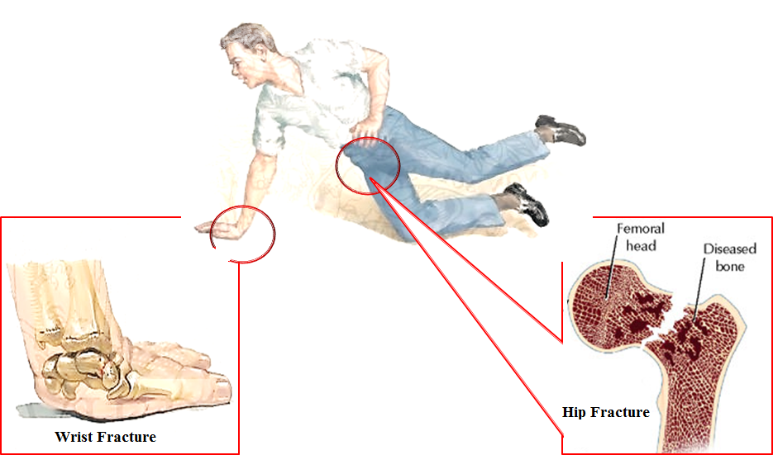
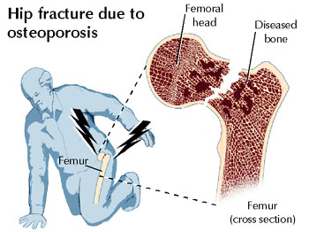

Slide 35
SYMPTOMS
A history of injury, followed by inability to use the injured limb.
The fracture may not always be at the site of the injury.
Eg : A blow to the knee and its varied effects.
If a fracture occurs with trivial trauma, or spontaneously, suspect a pathological lesion.
Pain
Bruising
Swelling
These are common symptoms but they do not distinguish a fracture from a soft-tissue injury.

Slide 36
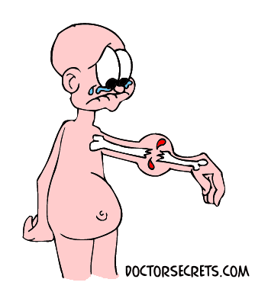
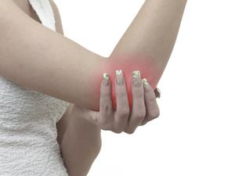
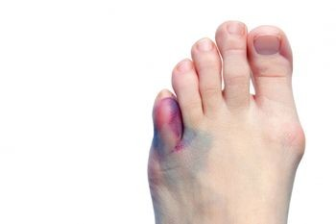

Slide 37
Deformity – More suggestive of a fracture.
Enquire about symptoms of associated injuries:
Pain and swelling elsewhere (it is a common mistake to get distracted by the main injury, particularly if it is severe),
Numbness or Loss of movement.
Skin pallor or cyanosis.
Blood in the urine.
Abdominal pain.
Difficulty with breathing.
Transient loss of consciousness.
Ask about previous injuries, or any other musculoskeletal abnormality that might cause confusion when the x-ray is seen. Finally, a general medical history is important, in preparation for anaesthesia or operation.

Slide 38
GENERAL SIGNS
First follow the ABCs: look for, and if necessary attend to,
Airway obstruction,
Breathing problems,
Circulatory problems
Cervical spine injury.
Secondary survey – Examine the main injury- ascertain the type of fracture, classify, plan a management protocol and look out for complications.
It will also be necessary to exclude other previously unsuspected injuries.

Slide 39
LOCAL SIGNS
Familiar headings of clinical examination should always be considered,
(or damage to arteries, nerves and ligaments may be overlooked.)
A systematic approach is always helpful:
Examine the most obviously injured part.
Test for artery and nerve damage.
Look for associated injuries in the region.
Look for associated injuries in distant parts.

Slide 40
LOOK
For Swelling, bruising and deformity
Examine whether the skin is intact
Note also the posture of the distal extremity and the colour of
the skin.

Slide 41
FEEL
The injured part is gently palpated for localized tenderness.
The common and characteristic associated injuries should also be felt for, even if the patient does not complain of them.
Vascular and peripheral nerve abnormalities should be tested for both before and after treatment.

Slide 42
MOVE
Crepitus and abnormal movement may be present.
More important to ascertain if the patient can move the joints distal to the injury.

Slide 43
X-RAY INVESTIGATION
X-ray examination is mandatory.
Rule of twos:
Two views – A fracture or a dislocation may not be seen on a single x-ray film, and at least two views (anteroposterior and lateral) must be taken.
Two limbs – In children, the appearance of immature epiphyses may confuse the diagnosis of a fracture; x-rays of the uninjured limb are needed for comparison.

Slide 44
Two films of the same tibia: the fracture may be ‘invisible’ in one
view and perfectly plain in a view at right angles to that.

Slide 45
Two limbs: Sometimes the abnormality can be appreciated only by comparison with the normal side; in this case
there is a fracture of the lateral condyle on the left side
R
L

Slide 46
Two joints – In the forearm or leg, one bone may be fractured and angulated. Angulation, however, is impossible unless the other bone is also broken, or a joint dislocated. The joints above and below the fracture must both be included on the x-ray films.
Two injuries – Severe force often causes injuries at more than one level. Eg: In fractures of the calcaneum or femur it is important to also x-ray the pelvis and spine.
Two occasions – Some fractures are notoriously difficult to detect soon after injury, but another x-ray examination a week or two later may show the lesion. Eg: Undisplaced fractures of the distal end of the clavicle, scaphoid, femoral neck and lateral malleolus, and also stress fractures and physeal injuries.

Slide 47
Two joints: The first x-ray (1) did not include the elbow.
This was, in fact, a Monteggia fracture – the head of the radius is dislocated; (2) shows the dislocated radiohumeral joint.

Slide 48
More than one occasion: A fractured scaphoid may not be obvious on the day of injury, but clearly seen 2 weeks later.

Slide 49
SPECIAL IMAGING
Computed tomography (CT) may be helpful in lesions of the spine or for complex joint fractures; help in accurate visualization of fractures in ‘difficult’ sites such as the calcaneum or acetabulum.
Magnetic resonance imaging (MRI) may be the only way of showing whether a fractured vertebra is threatening to compress the spinal cord.
Radioisotope scanning is helpful in diagnosing a suspected stress fracture or other undisplaced fractures.

Slide 50
FINAL DESCRIPTION
Diagnosing a fracture is not enough; the surgeon should describe it with its properties:
Is it open or closed?
Which bone is broken, and where?
Has it involved a joint surface?
What is the shape of the break?
Is it stable or unstable?
Is it a high-energy or a low-energy injury?
In short, the examiner must learn to recognize what has been aptly described as the ‘personality’ of the fracture.

Slide 51
Complications of Fracture

Slide 52
VISCERAL INJURIES

Slide 53
Often occur in fractures around the trunk
Penetration of lung by rib fractures which causes pneumothorax
Rupture of bladder or urethra in pelvic fractures
Require emergency treatment

Slide 54
VASCULAR INJURY

Slide 55
Injury | Vessel
First rib fracture | Subcalvian
Shoulder dislocation | Axillary
Humeral supracondylar fracture | Brachial
Elbow dislocation | Brachial
Pelvic fracture | Presacral and internal iliac
Femoral supracondylar fracture | Femoral
Knee dislocation | Popliteal
Proximal tibial | Popliteal or its branches

Slide 56
Clinical features
Paresthesia or numbness
Injured limb is cold and pale or slightly cyanosed
Weak or absent pulse

Slide 57
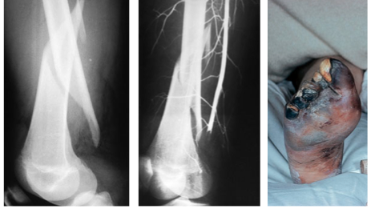
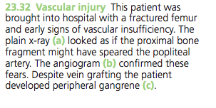

Slide 58
Treatment
All bandages and splints should be remove
Fractures re-x-rayed and if artery is being compressed prompt reduction is required
Circulation reassessed repeatedly over the next half hour
If no improvement, vessels must be explored by operation with pre or preoperative angiography

Slide 59
Cut vessel can be sutured, or a segment may be replaced by a vein graft, if it is thrombosed, endarterectomy may restore blood flow
If vessel repair is done, stable fixation is a must and fracture should be fixed internally

Slide 60
NERVE INJURY

Slide 61
Injury | Nerve
Shoulder dislocation | Axillary
Humeral shaft fracture | Radial
Humeral supracondylar fracture | Radial or median
Elbow medial condyle | Ulnar
Moteggia fracture-dislocation | Posterior-interosseous
Hip dislocation | Sciatic
Knee dislocation | peroneal

Slide 62
Closed nerve injuries
Seldom severe and spontaneous recovery occurs in 90% within 4 months
Nerve should be explored if no recovery, nerve conduction studies and EMG fail to show evidence of recovery

Slide 63
Open nerve injuries
Nerve should be explored at the time of debridement and repair at the time or at wound closure

Slide 64
Acute nerve compression
Sometimes occurs with # or dislocations around the wrist
Numbness or paraesthesia in distribution of the median or ulnar nerves
# reduction or splitting of bandages around the splint
If no improvement within 48 hours, nerve should be explored and decompressed

Slide 65
Indications for early exploration
Associated with open #
Fractures that need internal fixation
Presence of concomitant vascular injury
Diagnosed after manipulation of the #

Slide 66
HAEMARTHROSIS

Slide 67
# involving joint
Joint is swollen, tense and patient resist any attempt at moving at
Blood should be aspirated before dealing with #

Slide 68
INFECTION

Slide 69
Early infection
May present as wound inflammation without discharge
Causal organism
S. aureus
Pseudomonas
Antibiotics may allow # to proceed to union as long as fixation remains stable
But further surgery is likely later, when antibiotics are stopped

Slide 70
Late presentation
May present with a sinus and x-ray evidence of sequestra
Implants and all avascular pieces of bone should be removed
External fixator can be used to bridge the #
If resulting defect too large for bone grafting, patient should be referred to a limb reconstruction centre

Slide 71
When infection involves a joint, principles of treatment are the same as with bone infection, namely debridement and drainage, drugs and splintage
On resolution of infection, # is stabilize so that joint movement can recommence
If # cannot be stablized, joint should be splinted in the optimum position
Can lead to permanent stiffness

Slide 72
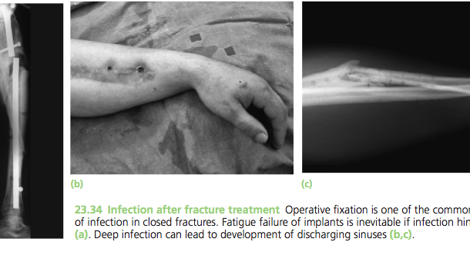

Slide 73
Compartment Syndrome
Occurs with fracture of elbow, forearm bones, proximal third of tibia, hands or foot ;
Crush injuries and circumferential burns
Increase of pressure within the osseofascial compartment
Due to bleeding , oedema or inflammation

Slide 74
Clinical features
Pain : bursting sensation
Altered sensibility
Paresis / weakness in active muscle contraction
Testing the muscle by stretching them ( ischemic muscle is highly sensitive to stretch and it causes pain )

Slide 75
Confirmation of diagnosis
Measuring the intracompartmental pressures
Introduced a split catheter into the compartment
Pressure measured close to level of the fracture
Differential pressure (difference between the diastolic pressure and compartment pressure ) is <30mmHg – immediate decompression
Management
Remove any casts, bandages and dressings
Differential pressure < 30mmHg – immediate fasciotomy

Slide 76
Gas gangrene
Produced by Clostridial infection
Present in dirty wound with dead muscle that are closed without adequate debridement
Toxins can cause necrosis of tissue and promote the spread of the disease

Slide 77
Clinical features
Within 24 hours of injury
Intense pain
swelling around the wound
Brownish discharge
Little or no pyrexia
Increase pulse rate
Characteristic smell
Patient rapidly become toxemia and may lapse into coma and death

Slide 78
Prevention
All dead tissue should be completely excised
Doubt about tissue viability – wound should be left open
Treatment
Early diagnosis
Fluid replacement & IV antibiotics
Hyperbaric O2 – limit the spread of gangrene
Prompt decompression of the wound and removal of dead tissue
Amputation in advance cases

Slide 79
Fracture Blisters
2 types
Clear fluid filled vesicles
Blood stained
Occur during limb swelling
Due to elevation of the epidermal layer of the skin from the dermis
No advantage in puncturing the blister ( cause local infection )
Surgical incision can be done after the limb swelling decrease

Slide 80
Plaster and Pressure Sores
Occur where the skin presses directly onto bone
Traction on a Thomas Splint ( wrong ring size, excessive fixed traction and neglect)
Prevention
Padding the bony points
Moulding the wet plaster so that pressure is distributed to the soft tissue around the bony points

Slide 81
Treatment
Patient feels the localized burning pain ( warning sign )
Window must be immediately cut in the plaster
If unnoticed, skin necrosis will progress

Slide 82
LATE COMPLICATIONS DELAYED UNION When a fracture takes more than usual time to unite, it is said to have gone in ‘delayed union’.

Slide 83
Causes Factors causing delayed union can be summarized as: biological, biomechanical or patient-related. BIOLOGICAL --Inadequate blood supply --Severe soft tissue damage affects fracture healing by: (1) reducing the effectiveness of muscle splintage (2) damaging the local blood supply and (3) diminishing or eliminating the osteogenic input from mesenchymal stem cells within muscle --Periosteal stripping

Slide 84
BIOMECHANICAL
--Imperfect splintage
--Over-rigid fixation
--Infection
PATIENT RELATED
In a less than ideal world, there are patients who are:
• Immense
• Immoderate
• Immovable
• Impossible.
These factors must be accommodated in an appropriate
fashion.

Slide 85
Clinical features -Fracture tenderness persists -Pain may be acute -On x-ray- fracture line remains visible - there is very little or incomplete callus formation or periosteal reaction - However, the bone ends are not sclerosed or atrophic (suggest that, although the fracture has not united, it eventually will)

Slide 86
Treatment
Conservative principles are:
(1) to eliminate any possible cause of delayed union
(2) to promote healing by providing the most appropriate
environment
Immobilization (whether by cast or by internal fixation) should be sufficient to prevent shear at the fracture site,
but fracture loading is an important stimulus to union and can be enhanced by:
(1) encouraging muscular exercise
(2) by weightbearing in the cast or brace

Slide 87
OPERATIVE --If union is delayed for more than 6 months and there is no sign of callus formation, internal fixation and bone grafting are indicated.

Slide 88
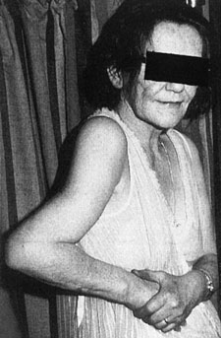
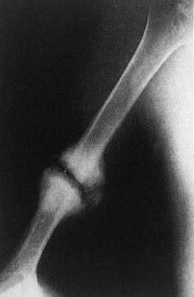
NON-UNION Delayed union gradually turns into non-union – that is it becomes apparent that the fracture will never unite without intervention
Movement can be elicited at the fracture site and pain
diminishes; the fracture gap becomes a type of pseudoarthrosis.
The X-ray shows a typical hypertrophic non union
This patient has an
obvious pseudarthrosis
of the humerus.

Slide 89
X-ray
-The fracture is clearly visible but the bone on either side of it may show either exuberant callus or atrophy
-This contrasting appearance has led to nonunion being divided into hypertrophic and atrophic types.
-In hypertrophic non-union the bone ends are enlarged, suggesting that osteogenesis is still active but not quite capable of bridging the gap
-In atrophic non-union, osteogenesis seems to have ceased

Slide 90
Causes Biological and patient related: (1) poor soft tissues (from either the injury or surgery) (2)local infection (3) associated drug abuse, anti-inflammatory or cytotoxic immunosuppressant medication (4) non-compliance on the part of the patient.

Slide 91
TREATMENT
CONSERVATIVE
Non-union is occasionally symptomless, needing no treatment or, at most, a removable splint with hypertrophic non-union, functional bracing may be sufficient to induce union, but splintage often needs to be prolonged.
Pulsed electromagnetic fields and low-frequency, pulsed ultrasound can also be used to stimulate union.

Slide 92
OPERATIVE
--hypertrophic non-union -- very rigid fixation alone (internal or external) may lead to union.
--atrophic non-union, fixation alone is not enough. Fibrous tissue in the fracture gap, as well as the hard, sclerotic bone ends is excised and bone grafts are packed around the fracture. If there is significant ‘die-back’, this will require more extensive excision and the gap is then dealt with by bone advancement using the Ilizarov technique.

Slide 93
Malunion
the fragments join in an unsatisfactory position (unacceptable angulation, rotation or shortening)
Causes are :
failure to reduce a fracture adequately
failure to hold reduction while healing proceeds
gradual collapse of comminuted or osteoporotic bone.

Slide 94
Common sites: fractures at the ends of a bone
E.g. supracondylar fracture of the humerus, Colles fracture.
Consequences:
Deformity
Shortening of the limb
Limitation of movements

Slide 95
X-rays are essential to check the position of the fracture while it is uniting.
Important during the first 3 weeks, when the situation may change without warning.

Slide 96
Treatment
1. In adults,
fractures should be reduced as near to the anatomical position as possible.
Angulation of more than 10–15 degrees in a long bone or a noticeable rotational deformity may need correction by remanipulation, or by osteotomy and fixation.

Slide 97
2. In children,
angular deformities near the bone ends (and especially if the deformity is in the same plane as that of movement of the nearby joint) will usually remodel with time;
rotational deformities will not.

Slide 98
3. In the lower limb,
shortening of more than 2.0 cm is seldom acceptable to the patient
a limb length equalizing procedure may be indicated.

Slide 99
Avascular Necrosis
Certain regions are notorious for their propensity to develop ischaemia and bone necrosis after injury
Common sites:
the head of the femur (after fracture of the femoral neck or dislocation of the hip)
the proximal part of the scaphoid (after fracture through its waist)
the lunate (following dislocation)
the body of the talus (after fracture of its neck).

Slide 100
Consequences
Deformation of the bone
Leads to secondary osteoarthritis a few years later
Painful limitation of joint movement

Slide 101
X-ray shows the characteristic increase in x-ray density, which occurs as a consequence of two factors:
Disuse osteoporosis in the surrounding parts gives the impression of ‘increased density’ in the necrotic segment,
and collapse of trabeculae compacts the bone and increases its density.

Slide 102
Treatment :
usually becomes necessary when joint function is threatened.
In old people with necrosis of the femoral head an arthroplasty is the obvious choice;
in younger people, realignment osteotomy (or, in some cases, arthrodesis) may be wiser.
Avascular necrosis in the scaphoid or talus may need no more than symptomatic treatment, but arthrodesis of the wrist or ankle is sometimes needed.

Slide 103
Growth Disturbance
In childern, due to damage to physis
Transverse fractures not dangerous as long it does run through germinal zone
Prevented by accurate reduction
Epiphysis splitting fractures -> asymmetrical growth and angulated bone ends
Complete cessation of growth – if entire physis is damaged.

Slide 104
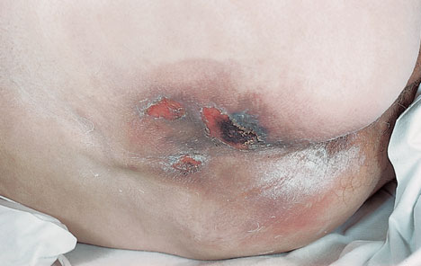
Bed Sores
Elderly or Paralysed
Skin over sacrum and heels – most vulnerable
Prevention by careful nursing and early activity
Treatment is difficult. By necrotic tissue excision and skin grafting
Vacuum assisted closure for sacral sores

Slide 105
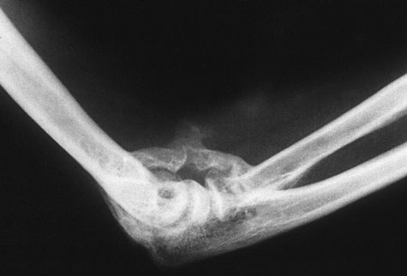
Myositis Ossificans
Heterotopic ossification after injury
Dislocation of elbow or blow to brachialis, deltoid or quadriceps
Pain , swelling and tenderness
Bone scan – increased activity
Limited joint movement
8 weeks , easily palpable , defined in x ray
Immobilization, Excision, NSAIDS ,Radiotherapy

Slide 106
Tendon Lesions
Tendinitis – Tibialis posterior tendon after medial malleolar fractures
Rupture of EPL tendon 6-12 weeks after fracture of lower radius
Corrected by transfer of extensor indicis proprius tendon

Slide 107
Nerve Compression
Lateral popliteal nerve – external rotation
Radial palsy – crutches
Numbness, paraesthesia, loss of power and wasting
Ulnar, Median and Posterior tibial nerve
Decompression

Slide 108
Muscle Contracture
Ischaemic contractures of affected muscles
Deformity and stiffness
Forearm and hand, leg and foot
Wasting and Clawing of fingers
Due to injuries and tight bandage
Calf ischemia – popliteal artery or its divisions
Tendon transfer

Slide 109
Joint Instability and Stiffness
Instability – Ligamentous laxity, muscle weakness and bone loss
Recurrent dislocation
Stiffness – knee, elbow ,shoulder ,small joints of hand
Hemarthrosis – synovial adhesions
Treatment is by exercise to prevent occurence

Slide 110
Sudeck’s dystrophy
Complex regional pain syndrome
Algodystrophy
Reflex sympathetic dystrophy
Type 1 – RSD develops after injurious or noxious event
Type 2 – Causalgia develops after nerve injury
Pain(burning),swelling,redness,pale skin and atrophy

Slide 111
Early recognition
Elevation and active exercises
NSAIDS, regional anaesthesia
Drugs like amitriptyline, carbamazepine and gabapentin
Physiotherapy

Slide 112
Osteoarthritis
Damage to articular cartilage –post traumatic
Irregular joint surface – local stress
Intra – articular osteotomies and repositioning of fragment
Malunion – secondary osteoarthritis

